Slide 1
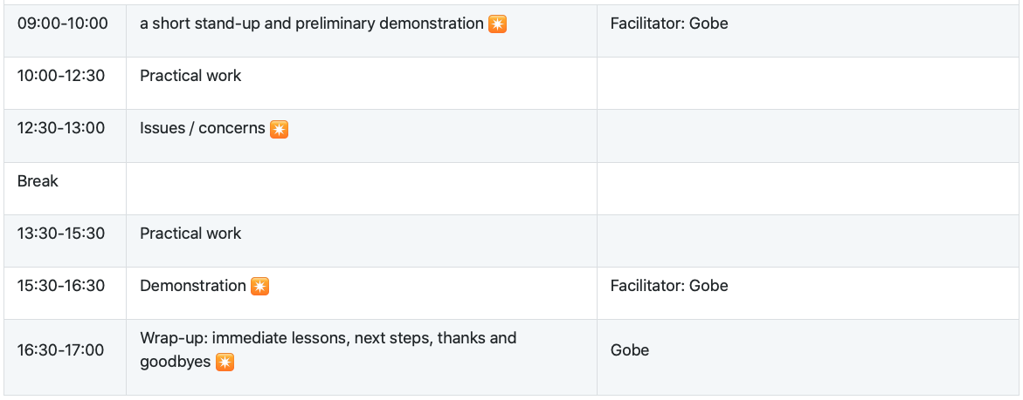
Sprint Day 2 Schedule: September 30th, 2020

